Slide 1
Casanova: a language for making games
Maggiore, Orsini, Bugliesi, Abbadi, Spanò, Steffinlongo

Slide 2
Casanova
Hybrid: functional, imperative, declarative
Succint
Integrated support for input, rendering, coroutines, etc.

Slide 3
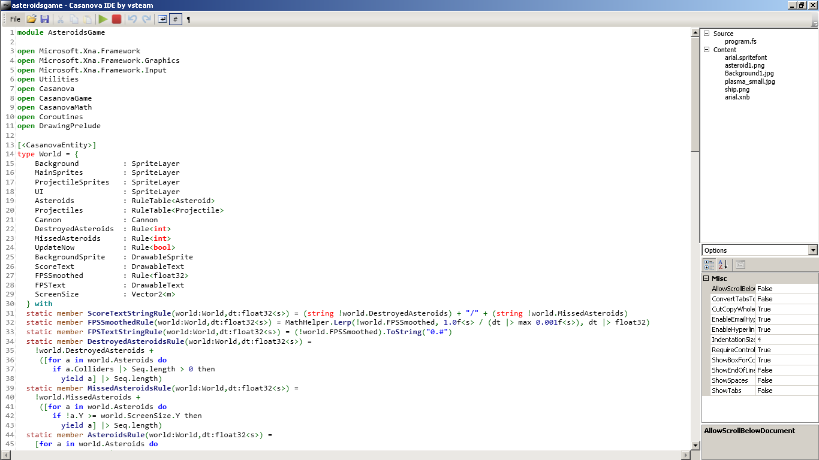
Casanova IDE

Slide 4
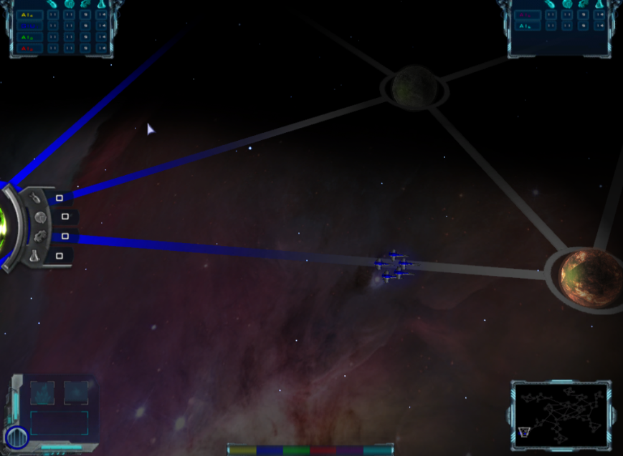
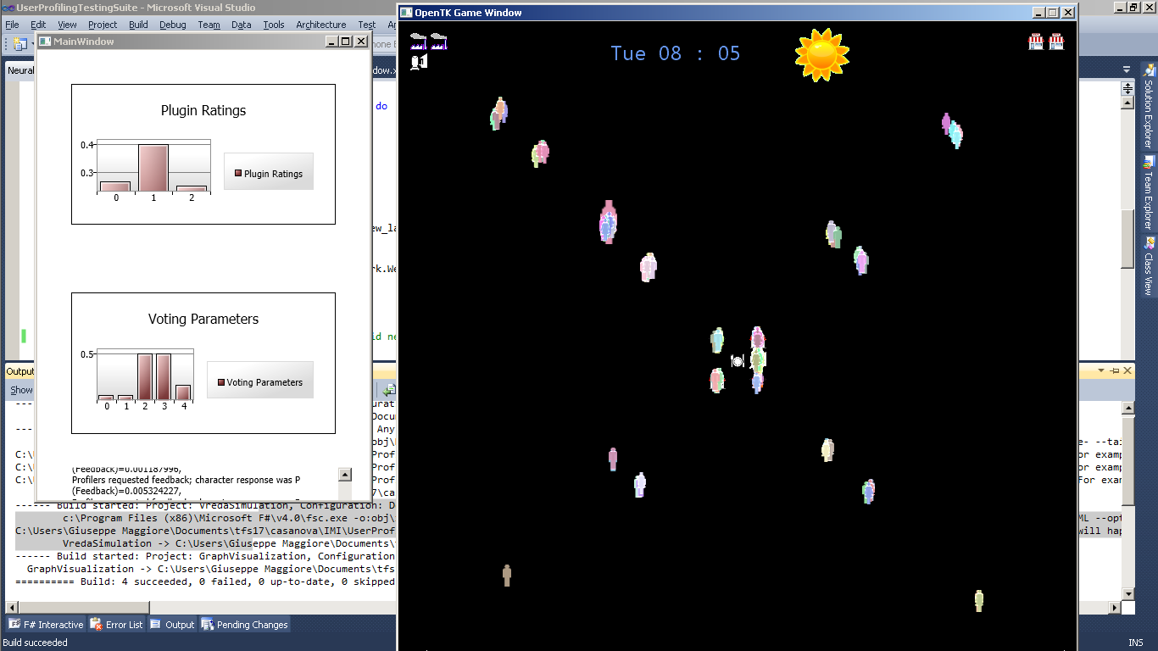
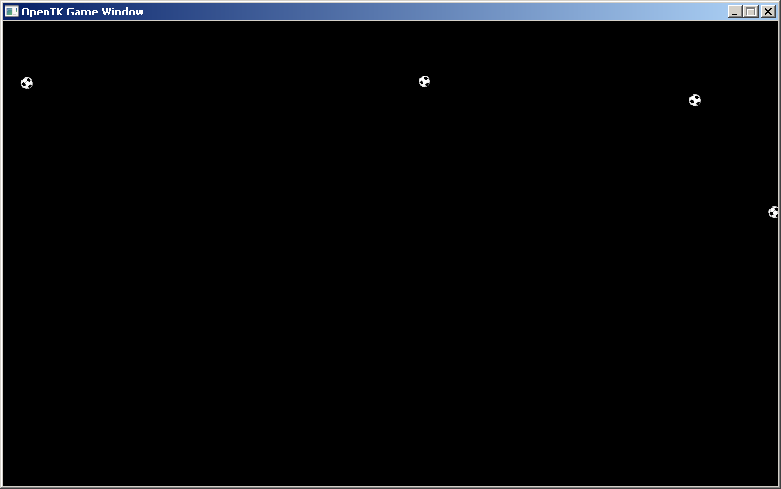
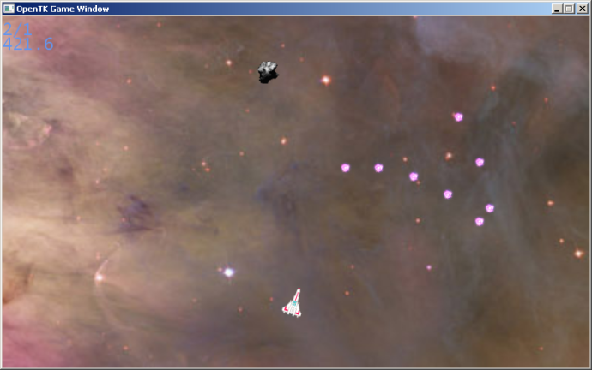
Casanova games

Slide 5
Come and see ☺

